Slide 1


Carbon Balance Method
Ryan Thompson
Department of Civil and Environmental Engineering

Slide 2
Carbon Balance Applications
EPA Reference Method for vehicle emission factors
EPA alternate method for stack sampling
Open biomass
Brick Kilns
Cookstoves
Notes:
Carbon balance search on the internet refers to the carbon in the earth system (soil, plants, ocean, atmosphere)

Slide 3
Carbon Balance for Cookstoves
Smith, K.R. et. al., 1993. Greenhouse gases from biomass and fossil fuel stoves in developing countries: A Manila Pilot Study. Chemosphere: http://ehs.sph.berkeley.edu/krsmith/publications/Chemo-03.pdf
Zhang, J. et. al., 1999. Greenhouse gases and other airborne pollutants from household stoves in China: A database for emission factors. Atmospheric Environment: http://ehs.sph.berkeley.edu/krsmith/publications/00_zhang_1.pdf
US EPA, 2000. Greenhouse gases from small scale combustion devices in developing countries: http://ehs.sph.berkeley.edu/krsmith/publications/00_smith_3.pdf
Bertschi I.T. et. al.,2003. Trace gas emissions from the production and use of domestic biofuels in Zambia measured by open-path Fourier transform infrared spectroscopy. Journal of Geophysical Research-Atmospheres.
Roden, C., Bond, T., 2006. Emission Factors and Real-Time Optical Properties Emitted from Traditional Wood Burning Cookstoves. Environmental Science and Technology.
Roden, C. et. al., 2009. Laboratory and field investigations of particulate and carbon monoxide emissions from traditional and improved cookstoves. Atmospheric Environment.
Chen, Y. et. al., 2012. Characterizing biofuel combustion with patterns of real-time emission data (PaRTED). Environmental Science and Technology

Slide 4
Carbon Balance Method Definition:
Balance the carbon in the emissions with the carbon in the fuel
Carbon Mass Balance Equation
C_{fuel} – C_{char} = C_{CO2} + C_{CO} + C_{THC} + C_{PM}
Where:
C_{fuel} mass of carbon in fuel (g)
C_{char} mass of carbon in remaining char (g)
C_{CO2} mass of carbon in carbon dioxide (g)
C_{CO} mass of carbon in carbon monoxide (g)
C_{THC} mass of carbon in total hydrocarbons (g)
C_{PM} mass of carbon in particulate matter (g)

Slide 5
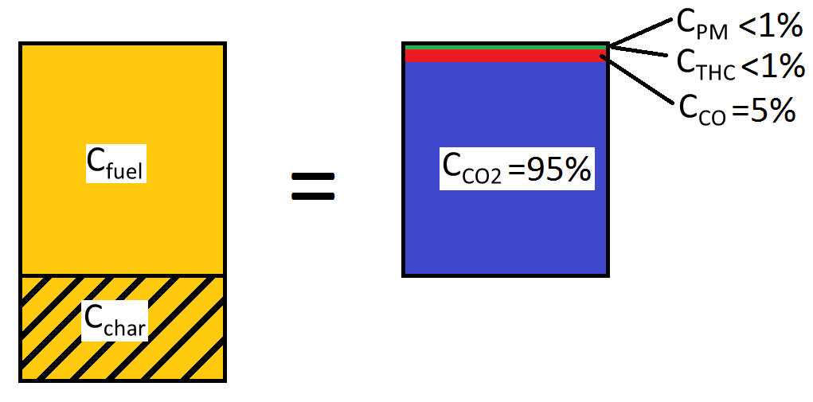
Carbon Mass Balance Equation
Carbon
Consumed
Carbon
Emitted
C_{fuel} – C_{char} = C_{CO2} + C_{CO} + C_{THC} + C_{PM}

Slide 6
Uses of the Carbon Balance Method
Total Capture Hood
Calculate real-time burn rate
Provide quality assurance check for the total capture method
Alternate method to calculate total emissions
Partial Capture Field Measurements
Calculate emission factors with limited equipment
Calculate total emissions

Slide 7
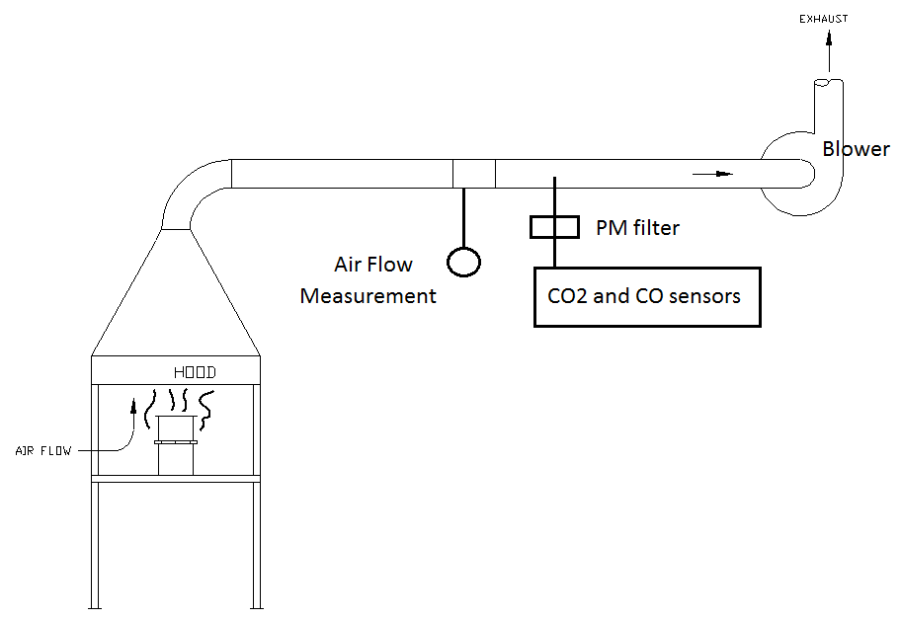
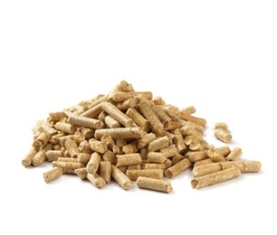
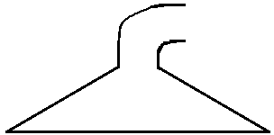
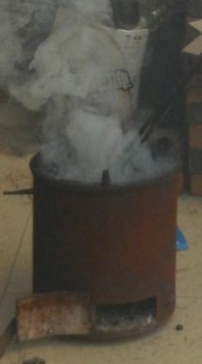
Total Capture Hood Carbon Balance for Real-Time Burn Rate
Emission rate = conc x flow
We can’t weigh the fuel every second but we can measure the emissions every second.

Slide 8
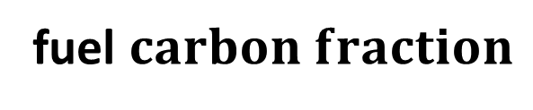
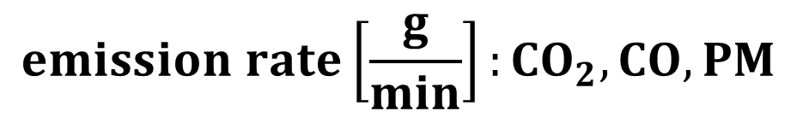
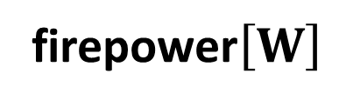

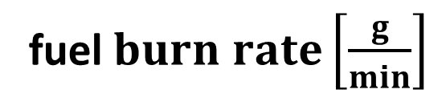
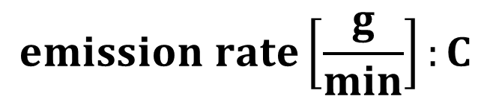

Total Capture Hood Carbon Balance for Real-Time Firepower
$${concentrations: CO}_{2}, CO, PM$$
Flow $\left[\frac{m^{3}}{min}\right]$
Total
Capture
$$emission rate\left[\frac{g}{min}\right]:{CO}_{2},CO,PM$$
$$emission rate\left[\frac{g}{min}\right]:C$$
fuel $carbon fraction$
Carbon Balance
fuel$burn rate\left[\frac{g}{min}\right]$
firepower$\left[W\right]$

Slide 9


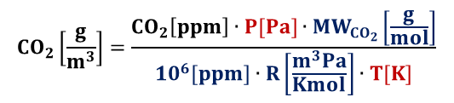


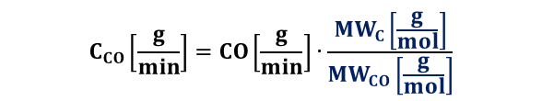
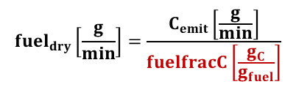

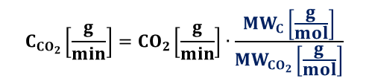



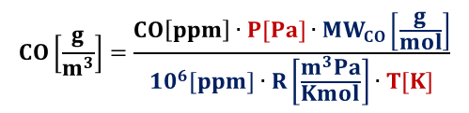
Total Capture Hood Carbon Balance for Real-Time Firepower
Total
Capture
$${CO}_{2}\left[ppm\right]={CO}_{2,now}\left[ppm\right]−{CO}_{2,bkg}\left[ppm\right]$$
$$CO\left[ppm\right]={CO}_{now}\left[ppm\right]−{CO}_{bkg}\left[ppm\right]$$
$${CO}_{2}\left[\frac{g}{m^{3}}\right]=\frac{{CO}_{2}\left[ppm\right]∙P[Pa]∙{MW}_{{CO}_{2}}\left[\frac{g}{mol}\right]}{{10}^{6}[ppm]∙R\left[\frac{m^{3}Pa}{Kmol}\right]∙T[K]}$$
$$CO\left[\frac{g}{m^{3}}\right]=\frac{CO\left[ppm\right]∙P[Pa]∙{MW}_{CO}\left[\frac{g}{mol}\right]}{{10}^{6}[ppm]∙R\left[\frac{m^{3}Pa}{Kmol}\right]∙T[K]}$$
$$PM\left[\frac{g}{m^{3}}\right]={PM}_{now}\left[\frac{g}{m^{3}}\right]−{PM}_{bkg}\left[\frac{g}{m^{3}}\right]$$
$${CO}_{2}\left[\frac{g}{min}\right]={CO}_{2}\left[\frac{g}{m^{3}}\right]∙Q\left[\frac{m^{3}}{min}\right]$$
$$CO\left[\frac{g}{min}\right]=CO\left[\frac{g}{m^{3}}\right]∙Q\left[\frac{m^{3}}{min}\right]$$
$$PM\left[\frac{g}{min}\right]=PM\left[\frac{g}{m^{3}}\right]∙Q\left[\frac{m^{3}}{min}\right]$$
$$C_{{CO}_{2}}\left[\frac{g}{min}\right]={CO}_{2}\left[\frac{g}{min}\right]∙\frac{{MW}_{C}\left[\frac{g}{mol}\right]}{{MW}_{{CO}_{2}}\left[\frac{g}{mol}\right]}$$
$$C_{CO}\left[\frac{g}{min}\right]=CO\left[\frac{g}{min}\right]∙\frac{{MW}_{C}\left[\frac{g}{mol}\right]}{{MW}_{CO}\left[\frac{g}{mol}\right]}$$
$$C_{PM}\left[\frac{g}{min}\right]=PM\left[\frac{g}{min}\right]∙PMfracC\left[\frac{g_{C}}{g_{PM}}\right]$$
$$C_{emit}\left[\frac{g}{min}\right]=C_{{CO}_{2}}\left[\frac{g}{min}\right]+C_{CO}\left[\frac{g}{min}\right]+C_{PM}\left[\frac{g}{min}\right]$$
Carbon Balance
$${fuel}_{dry}\left[\frac{g}{min}\right]=\frac{C_{emit}\left[\frac{g}{min}\right]}{fuelfracC\left[\frac{g_{C}}{g_{fuel}}\right]}$$
$${Firepower\left[W\right]=fuel}_{dry}\left[\frac{g}{min}\right]∙LHV\left[\frac{J}{g}\right]∙\frac{1[min]}{60[sec]}$$

Slide 10
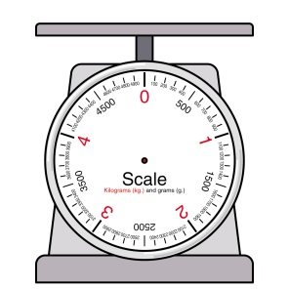
Total Capture Hood Carbon Balance for Quality Assurance
Total emission = conc x flow x time
compare

Slide 11



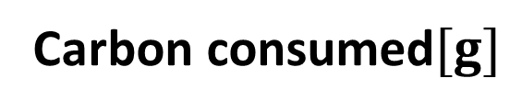
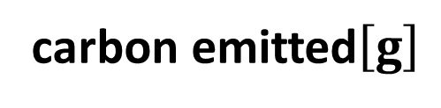


Total Capture Hood Carbon Balance for Quality Assurance
$${concentrations: CO}_{2}, CO, PM$$
flow $\left[\frac{m^{3}}{min}\right]$
time
Total
Capture
total emissions$\left[g\right]:{CO}_{2},CO,PM$
carbon emitted$\left[g\right]$
compare
Carbon consumed$[g]$
Char carbon
fraction
Fuel carbon
fraction
$$fuel[g]$$
$$char[g]$$
Carbon Balance
Scale

Slide 12
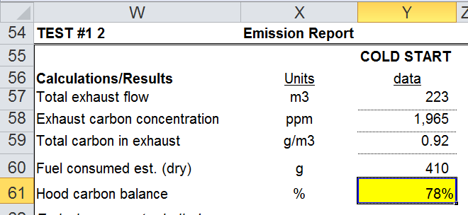
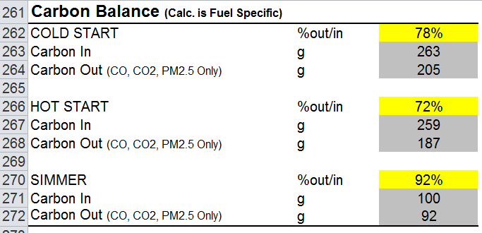
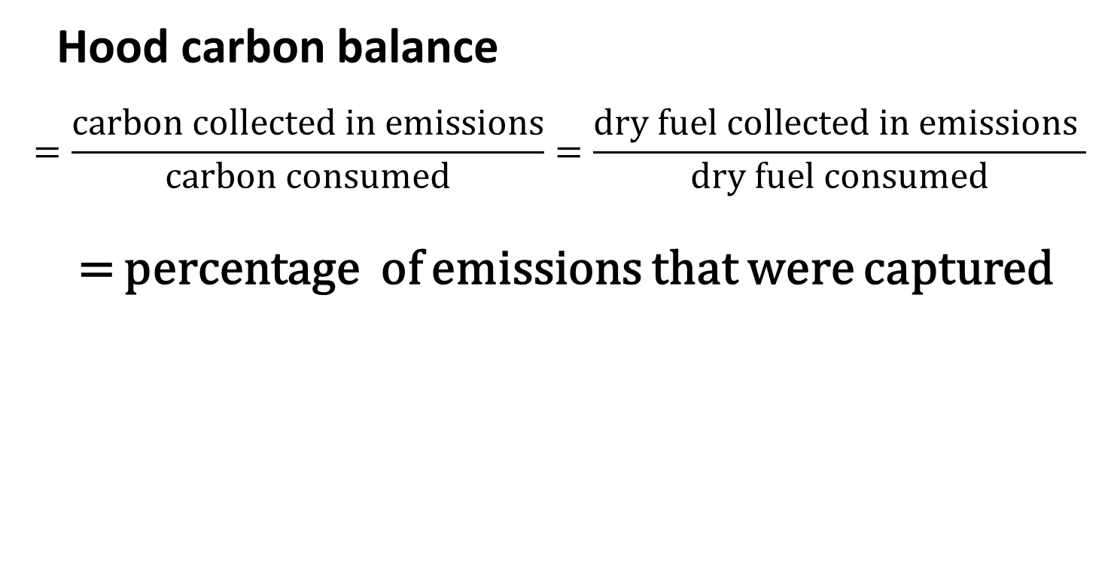
Total Capture Hood Carbon Balance for Quality Assurance
Hood carbon balance
$$=\frac{carbon collected in emissions}{carbon consumed}=\frac{dry fuel collected in emissions }{dry fuel consumed}$$
= percentage of emissions that were captured
WBT v5
Aprovecho v4.2.2

Slide 13








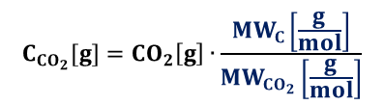





Total Capture Hood Carbon Balance for Quality Assurance
Total
Capture
$${CO}_{2}\left[ppm\right]={CO}_{2,now}\left[ppm\right]−{CO}_{2,bkg}\left[ppm\right]$$
$$CO\left[ppm\right]={CO}_{now}\left[ppm\right]−{CO}_{bkg}\left[ppm\right]$$
$${CO}_{2}\left[\frac{g}{m^{3}}\right]=\frac{{CO}_{2}\left[ppm\right]∙P[Pa]∙{MW}_{{CO}_{2}}\left[\frac{g}{mol}\right]}{{10}^{6}[ppm]∙R\left[\frac{m^{3}Pa}{Kmol}\right]∙T[K]}$$
$$CO\left[\frac{g}{m^{3}}\right]=\frac{CO\left[ppm\right]∙P[Pa]∙{MW}_{CO}\left[\frac{g}{mol}\right]}{{10}^{6}[ppm]∙R\left[\frac{m^{3}Pa}{Kmol}\right]∙T[K]}$$
$$PM\left[\frac{g}{m^{3}}\right]={PM}_{now}\left[\frac{g}{m^{3}}\right]−{PM}_{bkg}\left[\frac{g}{m^{3}}\right]$$
$${CO}_{2}\left[g\right]={CO}_{2}\left[\frac{g}{m^{3}}\right]∙Q\left[\frac{m^{3}}{min}\right]∙t[min]$$
$$CO\left[g\right]=CO\left[\frac{g}{m^{3}}\right]∙Q\left[\frac{m^{3}}{min}\right]∙t[min]$$
$$PM\left[g\right]=PM\left[\frac{g}{m^{3}}\right]∙Q\left[\frac{m^{3}}{min}\right]∙t[min]$$
$$C_{{CO}_{2}}[g]={CO}_{2}\left[g\right]∙\frac{{MW}_{C}\left[\frac{g}{mol}\right]}{{MW}_{{CO}_{2}}\left[\frac{g}{mol}\right]}$$
$$C_{CO}[g]=CO\left[g\right]∙\frac{{MW}_{C}\left[\frac{g}{mol}\right]}{{MW}_{CO}\left[\frac{g}{mol}\right]}$$
$$C_{PM}[g]=PM\left[g\right]∙PMfracC\left[\frac{g_{C}}{g_{PM}}\right]$$
$$C_{emit}\left[g\right]=C_{{CO}_{2}}\left[g\right]+C_{CO}\left[g\right]+C_{PM}[g]$$
$$C_{char}=char\left[g\right]∙charfracC\left[\frac{g_{C}}{g_{char}}\right]$$
$$char\left[g\right]={char}_{f}[g]−{char}_{i}[g]$$
Scale
$$C_{cons}\left[g\right]=C_{fuel}\left[g\right]−C_{char}\left[g\right]$$
$${fuel}_{dry}\left[g\right]={fuel}_{wet}[g]∙(1−{MC}_{wet})$$
$$hood carbon balance= \frac{C_{emit}}{C_{cons}}$$
$$C_{fuel}[g]={fuel}_{dry}\left[g\right]∙fuelfracC\left[\frac{g_{C}}{g_{fuel}}\right]$$
$${fuel}_{wet}\left[g\right]={fuel}_{f}\left[g\right]−{fuel}_{i}[g]$$

Slide 14
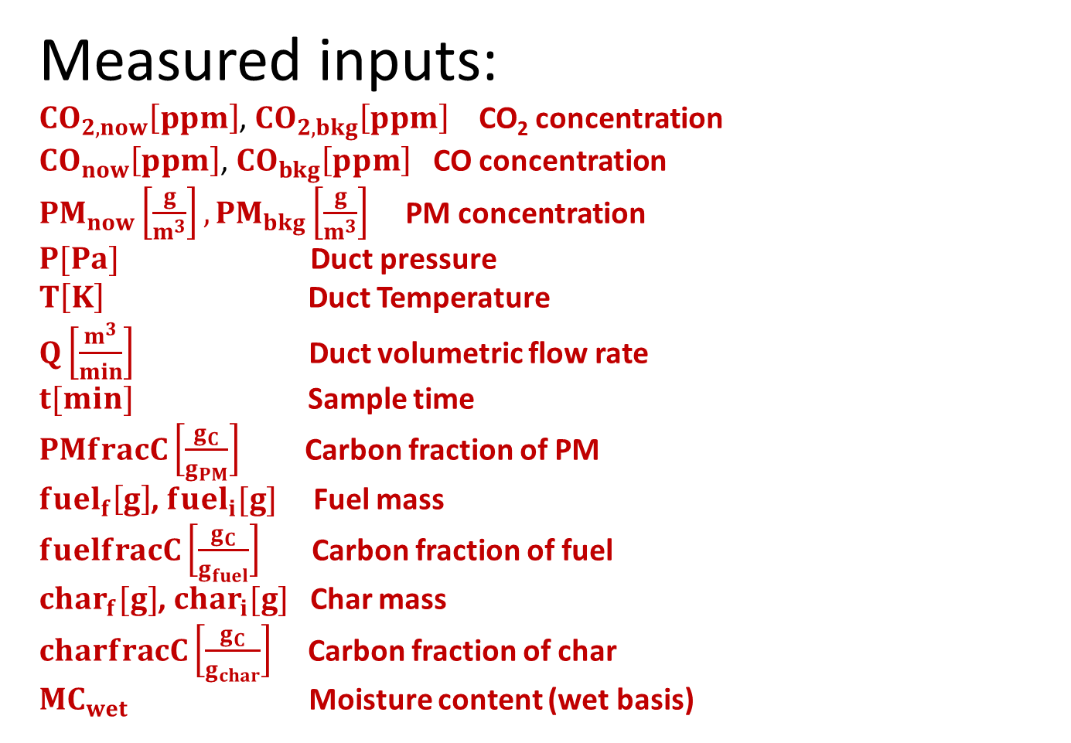
Total Capture Hood Carbon Balance for Quality Assurance
Measured inputs:
${CO}_{2,now}\left[ppm\right]$, ${CO}_{2,bkg}\left[ppm\right]$ CO₂ concentration
${CO}_{now}\left[ppm\right]$, ${CO}_{bkg}\left[ppm\right]$ CO concentration
${PM}_{now}\left[\frac{g}{m^{3}}\right],{PM}_{bkg}\left[\frac{g}{m^{3}}\right]$ PM concentration
$P[Pa]$ Duct pressure
$T\left[K\right]$ Duct Temperature
$Q\left[\frac{m^{3}}{min}\right]$ Duct volumetric flow rate
$t[min]$ Sample time
$PMfracC\left[\frac{g_{C}}{g_{PM}}\right]$ Carbon fraction of PM
${fuel}_{f}\left[g\right]$, ${fuel}_{i}[g]$ Fuel mass
$fuelfracC\left[\frac{g_{C}}{g_{fuel}}\right]$ Carbon fraction of fuel
${char}_{f}[g]$, ${char}_{i}[g]$ Char mass
$charfracC\left[\frac{g_{C}}{g_{char}}\right]$ Carbon fraction of char
${MC}_{wet}$ Moisture content (wet basis)

Slide 15
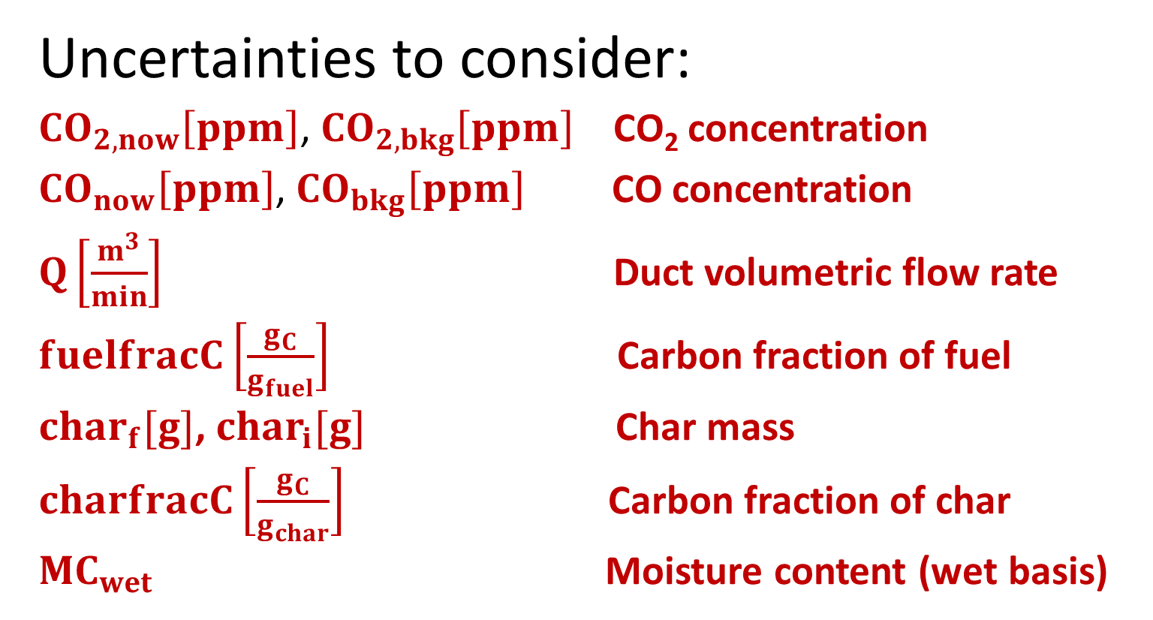
Total Capture Hood Carbon Balance for Quality Assurance
If the carbon doesn’t balance…
Uncertainties to consider:
${CO}_{2,now}\left[ppm\right]$, ${CO}_{2,bkg}\left[ppm\right]$ CO₂ concentration
${CO}_{now}\left[ppm\right]$, ${CO}_{bkg}\left[ppm\right]$ CO concentration
$Q\left[\frac{m^{3}}{min}\right]$ Duct volumetric flow rate
$fuelfracC\left[\frac{g_{C}}{g_{fuel}}\right]$ Carbon fraction of fuel
${char}_{f}[g]$, ${char}_{i}[g]$ Char mass
$charfracC\left[\frac{g_{C}}{g_{char}}\right]$ Carbon fraction of char
${MC}_{wet}$ Moisture content (wet basis)

Slide 16
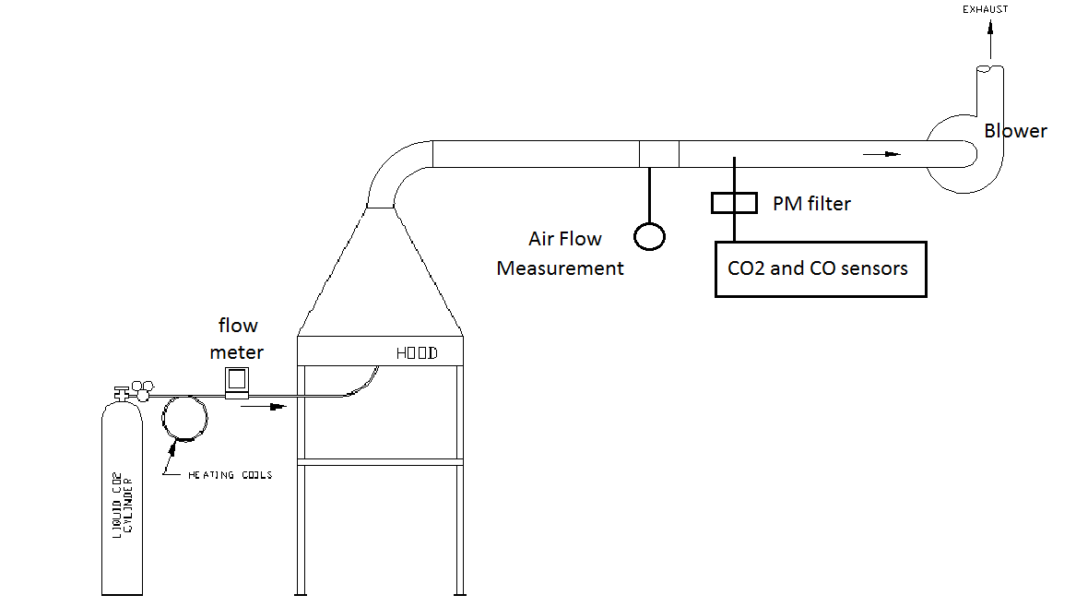
100% CO₂ Injection
Total Capture Hood Carbon Balance for Quality Assurance

Slide 17

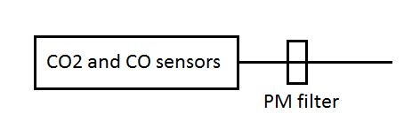
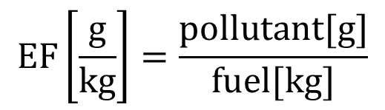
Partial Capture Carbon Balance Emission Factors
$$EF\left[\frac{g}{kg}\right]=\frac{pollutant[g]}{fuel[kg]}$$

Slide 18
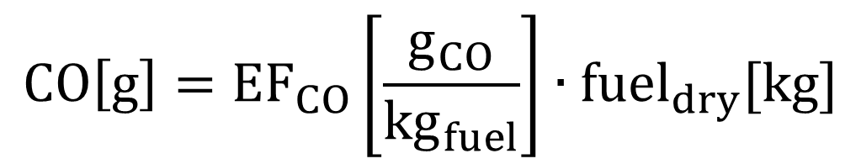
Partial Capture Carbon Balance Total Emissions
$$CO\left[g\right]={EF}_{CO}\left[\frac{g_{CO}}{{kg}_{fuel}}\right]∙{fuel}_{dry}[kg]$$
Calculate total emissions without collecting the total emissions

Slide 19
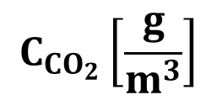
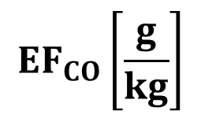


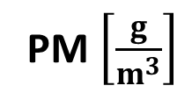
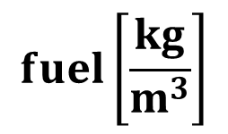


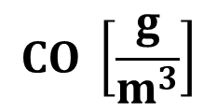
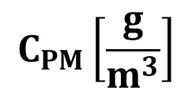

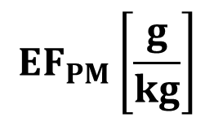
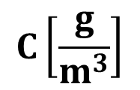
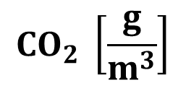
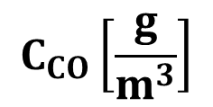
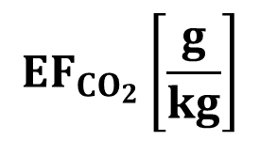
Partial Capture Carbon Balance
$${CO}_{2} [ppm]$$
$$CO [ppm]$$
Ideal gas law
$${CO}_{2}\left[g\right]$$
$$CO\left[g\right]$$
$$PM\left[g\right]$$
$${CO}_{2} \left[\frac{g}{m^{3}}\right]$$
$$CO \left[\frac{g}{m^{3}}\right]$$
PM$\left[\frac{g}{m^{3}}\right]$
weigh fuel
carbon
fraction
molecular weight
$${EF}_{{CO}_{2}}\left[\frac{g}{kg}\right]$$
$${EF}_{CO}\left[\frac{g}{kg}\right]$$
$${EF}_{PM}\left[\frac{g}{kg}\right]$$
$$C_{{CO}_{2}}\left[\frac{g}{m^{3}}\right]$$
$$C_{CO}\left[\frac{g}{m^{3}}\right]$$
$$C_{PM}\left[\frac{g}{m^{3}}\right]$$
$$fuel\left[\frac{kg}{m^{3}}\right]$$
$$C\left[\frac{g}{m^{3}}\right]$$
carbon
fraction
Notes:
Don’t know know much

Slide 20



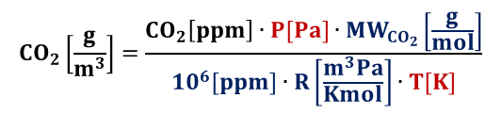
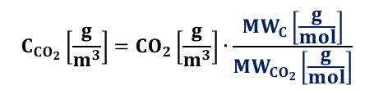





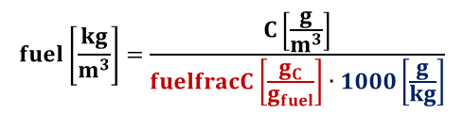
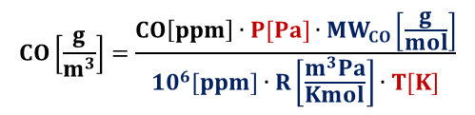
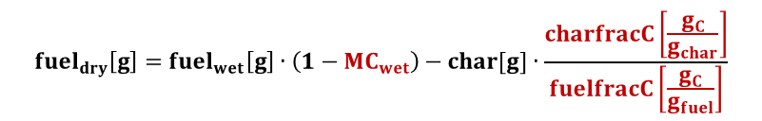





Partial Capture Carbon Balance
$${CO}_{2}\left[ppm\right]={CO}_{2,now}\left[ppm\right]−{CO}_{2,bkg}\left[ppm\right]$$
$$CO\left[ppm\right]={CO}_{now}\left[ppm\right]−{CO}_{bkg}\left[ppm\right]$$
$${CO}_{2}\left[\frac{g}{m^{3}}\right]=\frac{{CO}_{2}\left[ppm\right]∙P[Pa]∙{MW}_{{CO}_{2}}\left[\frac{g}{mol}\right]}{{10}^{6}[ppm]∙R\left[\frac{m^{3}Pa}{Kmol}\right]∙T[K]}$$
$$CO\left[\frac{g}{m^{3}}\right]=\frac{CO\left[ppm\right]∙P[Pa]∙{MW}_{CO}\left[\frac{g}{mol}\right]}{{10}^{6}[ppm]∙R\left[\frac{m^{3}Pa}{Kmol}\right]∙T[K]}$$
$$PM\left[\frac{g}{m^{3}}\right]={PM}_{now}\left[\frac{g}{m^{3}}\right]−{PM}_{bkg}\left[\frac{g}{m^{3}}\right]$$
$$C_{{CO}_{2}}\left[\frac{g}{m^{3}}\right]={CO}_{2}\left[\frac{g}{m^{3}}\right]∙\frac{{MW}_{C}\left[\frac{g}{mol}\right]}{{MW}_{{CO}_{2}}\left[\frac{g}{mol}\right]}$$
$$C_{CO}\left[\frac{g}{m^{3}}\right]=CO\left[\frac{g}{m^{3}}\right]∙\frac{{MW}_{C}\left[\frac{g}{mol}\right]}{{MW}_{CO}\left[\frac{g}{mol}\right]}$$
$$C_{PM}\left[\frac{g}{m^{3}}\right]=PM\left[\frac{g}{m^{3}}\right]∙PMfracC\left[\frac{g_{C}}{g_{PM}}\right]$$
$${EF}_{{CO}_{2}}\left[\frac{g}{kg}\right]=\frac{{CO}_{2}\left[\frac{g}{m^{3}}\right]}{fuel\left[\frac{kg}{m^{3}}\right]}$$
$${{CO}_{2}\left[g\right]=EF}_{{CO}_{2}}\left[\frac{g}{kg}\right]∙{fuel}_{dry}\left[g\right]$$
$$C\left[\frac{g}{m^{3}}\right]=C_{{CO}_{2}}\left[\frac{g}{m^{3}}\right]+C_{CO}\left[\frac{g}{m^{3}}\right]+C_{PM}\left[\frac{g}{m^{3}}\right]$$
$${EF}_{CO}\left[\frac{g}{kg}\right]=\frac{CO\left[\frac{g}{m^{3}}\right]}{fuel\left[\frac{kg}{m^{3}}\right]}$$
$${CO\left[g\right]=EF}_{CO}\left[\frac{g}{kg}\right]∙{fuel}_{dry}\left[g\right]$$
Emission
Factors
$$fuel\left[\frac{kg}{m^{3}}\right]=\frac{C\left[\frac{g}{m^{3}}\right]}{fuelfracC\left[\frac{g_{C}}{g_{fuel}}\right]∙1000\left[\frac{g}{kg}\right]}$$
$${EF}_{PM}\left[\frac{g}{kg}\right]=\frac{PM\left[\frac{g}{m^{3}}\right]}{fuel\left[\frac{kg}{m^{3}}\right]}$$
$${PM\left[g\right]=EF}_{PM}\left[\frac{g}{kg}\right]∙{fuel}_{dry}\left[g\right]$$
Total
Emissions
$${fuel}_{dry}\left[g\right]={fuel}_{wet}\left[g\right]∙\left(1−{MC}_{wet}\right)−char[g]∙\frac{charfracC\left[\frac{g_{C}}{g_{char}}\right]}{fuelfracC\left[\frac{g_{C}}{g_{fuel}}\right]}$$
$$char\left[g\right]={char}_{f}[g]−{char}_{i}[g]$$
Scale
$${fuel}_{wet}\left[g\right]={fuel}_{f}\left[g\right]−{fuel}_{i}[g]$$

Slide 21
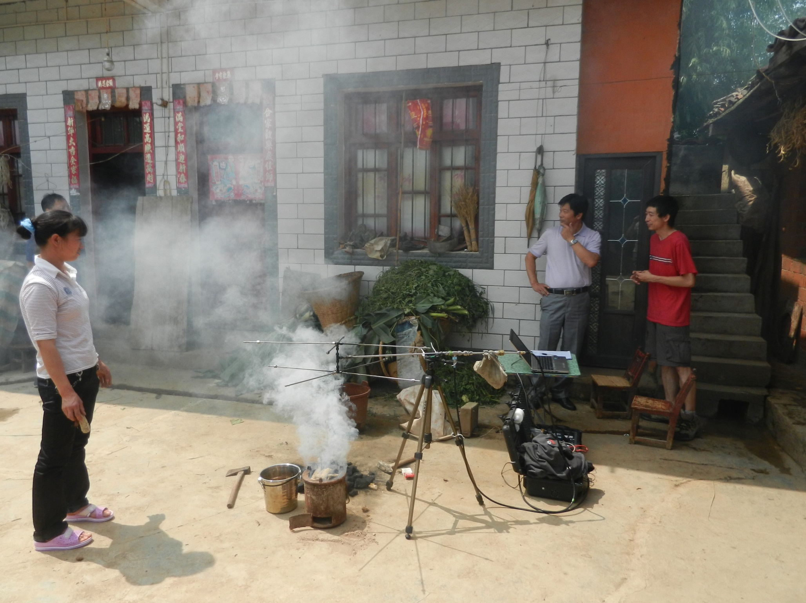

Slide 22
Partial Capture Carbon Balance
Advantages
Calculate emission factors with small sample probe
Calculate total emissions without collecting total emissions
No flow measurement required – more appropriate if uncertain flows
Unaffected by dilution
Allows field measurements with portable, cheap equipment
Opens a new frontier of emission sampling
Makes emission sampling accessible to more people
Disadvantages
Requires good understanding of the fuel, such as the carbon fraction.

Slide 23




Lab Tests: Total Capture or Partial Capture?
$$=\frac{pollutant[g]}{fuel[kg]}$$
$$=\frac{pollutant\left[g/m^{3}\right]}{fuel[kg/m^{3}]}$$
Measure flow
Measure fuel
Measure emissions ratio
Know fuel carbon fraction.
$$=conc×flow×time$$
$$=EF\left[\frac{g}{kg}\right]×fuel[kg]$$
Measure flow
Measure fuel

Slide 24
Conclusion
The carbon balance is useful in the lab
to measure real time fuel consumption, firepower, and emission factors
Check total capture emission measurements
Calculate total emissions
The carbon balance allows field measurements of emission factors and total emissions with portable equipment

Slide 25
Thanks
Jim Jetter, US EPA
Tami Bond, Cheryl Weyant, University of lllinois

